Slide 1
Analysis of Variance
One-way ANOVA
Maverick Smith mavericks@wustl.edu
Pronouns: he/him

Slide 2

Daily Review
What analysis would we run in each scenario?
Intervention targeting parental awareness of adolescent mental health issues. Parents took a knowledge quiz (A) before and after (B) an intervention (Deitz, Cook, Billings, & Hendrickson, 2009)
Elementary school students got either a physical fitness intervention or no intervention. Researchers examined physical performance 4 months later (Matvienko & Ahrabi-Farb, 2010)
Paired samples t-test
Independent samples t-test

Slide 3
Remember t-tests?
Used to compare two groups
Independent variable: Nominal or ordinal with 2 levels/categories
Dependent variable: Ratio or interval scale response variable
2 groups is rare

Slide 4
Analysis of Variance (ANOVA)
Used to compare more than two means
Independent variable: Nominal or ordinal with > 2 levels
Dependent variable: Ratio or interval scale response variable

Slide 5

Give me an example
Give me an example when you may compare 3 independent groups
What is the IV/Factor?
What are the 3 levels of the independent variable?
What is the dependent variable?

Slide 6

Running 3 t-tests
Alpha: .05
Probability of finding at least one sig. differences increases as we increase # of tests
p(1 or more) = 1-((1 - .05)^{m})
p(1 or more) = 1-((1 - .05)³)
p(1 or more) = .14
Probability that at least one test is significant even though the null is true
This is too high!! We only want a 5% chance of a Type I error.
m = # of tests
Notes:
The more dice we roll, the higher the probability that one of the dice will land on a 1.
The probability of making NO errors raised to the power of the probability of making NO errors for this many tests. 1 minus that gives the probability that at least one test is significant by chance .

Slide 7
What if there were 6 groups?
How many t-tests would you run?
15 tests
p(1 or more) = 1-((1 - .05)¹⁵)
p(1 or more) = .54
Family-wise error rate
A 54% chance of finding one significant difference when there really is no difference is too high!

Slide 8
One-Way ANOVA hypotheses
H_{Null}: μ_{Group1} = μ _{Group2} = μ _{Group3}; All the means are equal.
H_{Alternative}: At least one of the means is different.
μ_{Group1} ≠ μ_{Group2}
μ_{Group2} ≠ μ_{Group3}
μ_{Group1} ≠ μ_{Group3}
μ_{Group1} ≠ μ_{Group2} ≠ μ_{Group3}

Slide 9
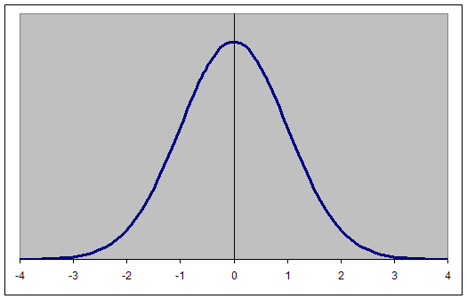


Normal Distribution
$$\frac{\sum{{\left(yi −\overline{y}\right)}^{2}}}{N −1}$$
$$\overline{y}$$

Slide 10
Variance
$$\frac{\sum{{\left(yi −\overline{y}\right)}^{2}}}{N −1}$$

Slide 11
Variance
$$\frac{\sum{{\left(yi −\overline{y}\right)}^{2}}}{N −1}$$

Slide 12
Variance
$$\frac{\sum{{\left(yi −\overline{y}\right)}^{2}}}{N −1}$$

Slide 13


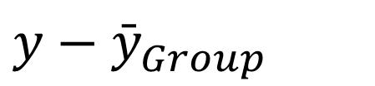
Rationale of ANOVA
Variability in your data can be divided into two sources:
Total Variability
Between Group Variability
Within Group Variability
$$y−{\overline{y}}_{Grand}$$
$${\bar{y}}_{Group}−{\bar{y}}_{Grand}$$
=
$$y−{\bar{y}}_{Group}$$
+

Slide 14


Total Variability
Individual Score
$$yi$$
$${\overline{y}}_{Grand}$$
Grand Mean

Slide 15

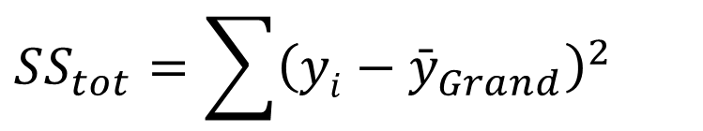
Total Variability
$$\frac{\sum{{\left(yi −\overline{y}\right)}^{2}}}{N −1}$$
$$SS_{tot}=\sum{{\left(yi−{\bar{y}}_{Grand}\right)}^{2}}$$

Slide 16
Between Group Variability
The null hypothesis is that all the group means are the same, i.e., the same as the grand mean
Group 1
Group 2
Group 3

Slide 17



Between Group Variability
But each group varies around the grand mean
Group 1
Group 2
Group 3
$${\bar{y}}_{Grp1}$$
$${\bar{y}}_{Grp2}$$
$${\bar{y}}_{Grp3}$$

Slide 18

Between Group Variability
Sums of Squares Between Groups
$$SS_{BG}=\sum{n_{group}{\left({\bar{y}}_{Group}−{\bar{y}}_{Grand}\right)}^{2}}$$
or
$$SS_{BG}=n_{group1}{\left({\bar{y}}_{group1}−{\bar{y}}_{Grand}\right)}^{2}+n_{group2}{\left({\bar{y}}_{group2}−{\bar{y}}_{Grand}\right)}^{2}+n_{group3}{\left({\bar{y}}_{group3}−y_{Grand}\right)}^{2}$$
The more different the groups are = The larger the Between Group Variability

Slide 19

Within Group Variability
We also have variability within each group
This variability represents “error” or variability that is not due to the IV
Individual Score
$$y$$
Group 1
Group 2
Group 3
$${\bar{y}}_{Grp1}$$
$${\bar{y}}_{Grp2}$$
$${\bar{y}}_{Grp3}$$

Slide 20
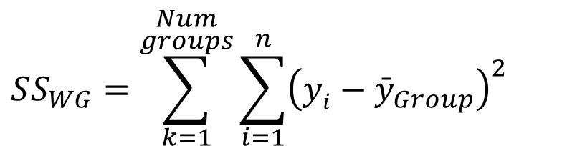
Within Group Variability
Sums of Squares Within Groups
$$SS_{WG}=\sum_{k=1}^{\begin{aligned}Num \\ groups\end{aligned}}{\sum_{i=1}^{n}{{\left(yi−{\bar{y}}_{Group}\right)}^{2}}}$$
n = number of participants within group
But there is an easier way. . .

Slide 21

Within Group Variability
Sums of Squares Within Groups
$$SS_{tot}=SS_{BG}+SS_{WG}$$
$$SS_{tot}−SS_{BG}=SS_{WG}$$

Slide 22
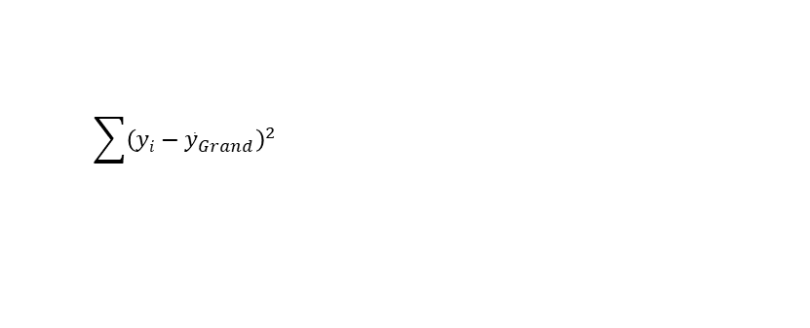
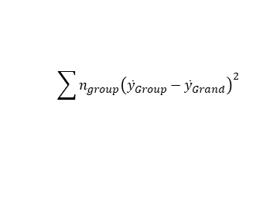
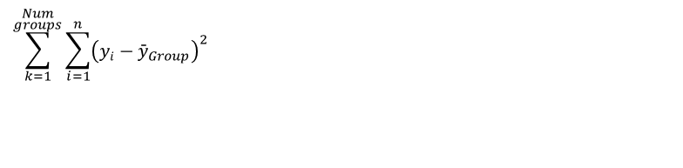
The ANOVA Table
Source | SS | df | MS | F
Between Groups
Within Groups
Total
$$\sum{n_{group}{\left({\bar{y}}_{Group}−{\bar{y}}_{Grand}\right)}^{2}}$$
$$\sum_{k=1}^{\begin{aligned}Num \\ groups\end{aligned}}{\sum_{i=1}^{n}{{\left(yi−{\bar{y}}_{Group}\right)}^{2}}}$$
$$\sum{{\left(yi−{\bar{y}}_{Grand}\right)}^{2}}$$

Slide 23
From Sums of Squares to the F-ratio
To convert SS to an F, we need to calculate degrees of freedom
SS_{BG} and SS_{WG} are dependent on the number of observations and the number of groups
DF = Number of unique data points that contribute to the calculation minus the number of constraints

Slide 24
Degrees of Freedom
Between group variability
Number of Groups - 1
Within group variability
Number of participants – Number of Groups
Total variability
Number of participants - 1

Slide 25
The ANOVA Table
Source | SS | df | MS | F
Between Groups | 127.20 | N_{groups} - 1
Within Groups | 208.50 | N_{participants} - N_{groups}
Total | 335.70 | N_{participants} - 1

Slide 26
The ANOVA Table
Source | SS | df | MS | F
Between Groups | 127.20
Within Groups | 208.50
Total | 335.70
2
27
29

Slide 27

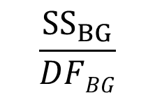
The ANOVA Table
Source | SS | df | MS | F
Between Groups | 127.20
Within Groups | 208.50
Total | 335.70
2
$$\frac{SS_{BG}}{DFBG}$$
27
$$\frac{SS_{WG}}{\text{DF}\text{WG} }$$
29

Slide 28


The ANOVA Table
Source | SS | df | MS | F
Between Groups | 127.20
Within Groups | 208.50
Total | 335.70
2
$$\frac{127.20}{2}$$
27
$$\frac{208.50}{27}$$
29

Slide 29

The ANOVA Table
Source | SS | df | MS | F
Between Groups | 127.20 |  | 63.60
Within Groups | 208.50 |  | 7.72
Total | 335.70
2
$$\frac{MS_{BG}}{MS_{WG}}$$
27
29

Slide 30
The ANOVA Table
Source | SS | df | MS | F
Between Groups | 127.20 |  | 63.60 | 8.23
Within Groups | 208.50 |  | 7.72
Total | 335.70
2
27
29

Slide 31

The Big Picture
$$F_{obt}=\frac{MS_{BG}}{MS_{WG}}$$
What happens to the F value if between group variability is larger than the within group variability?
What happens to the F value if the between group variability is smaller than the within group variability

Slide 32
Jamovi

Slide 33
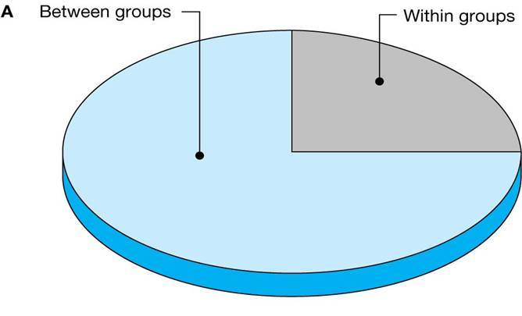
Rationale for ANOVA
If the independent variable has an effect
Creates more between group variability than within group variability
F ratio would be larger than 1

Slide 34
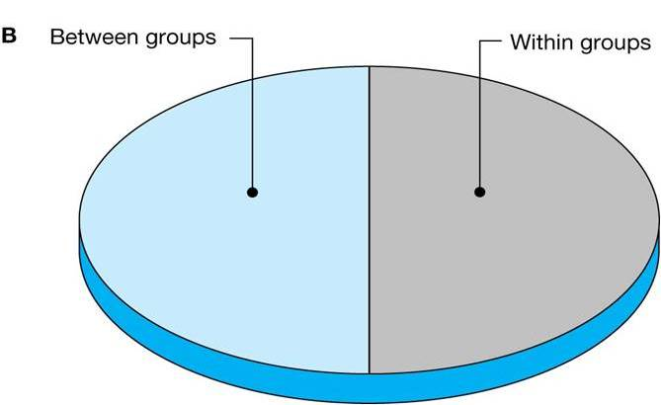
Rationale for ANOVA
If the independent variable has no effect
No variability between groups
F ratio would be close to 1

Slide 35
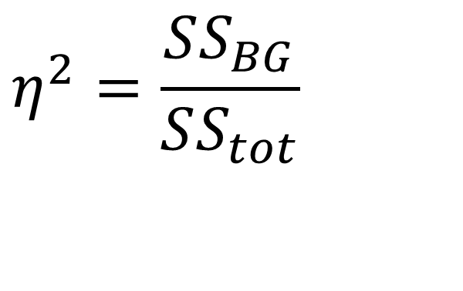
Effect Size
Eta squared
Proportion of variance accounted for by the independent variable
Rule of thumb
≈.10 is small
≈ .30 is medium
≈.50 is large

Slide 36
One-Way ANOVA hypotheses
H_{Null}: μ_{Group1} = μ _{Group2} = μ _{Group3}; All the means are equal.
H_{Alternative}: At least one of the means is different.
μ_{Group1} ≠ μ_{Group2}
μ_{Group2} ≠ μ_{Group3}
μ_{Group1} ≠ μ_{Group3}
μ_{Group1} ≠ μ_{Group2} ≠ μ_{Group3}
But which groups?

Slide 37
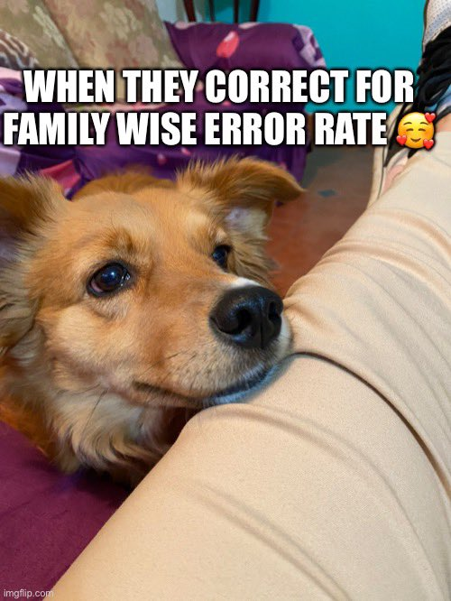
Post Hoc Comparisons
Determine which groups differ from each other
Conduct after you find a significant F ratio
There are several different variants and a lot of debate in the literature
Fisher’s Least Squared Difference (LSD)
Dunnett’s
Tukey’s Honest Significant Difference (HSD)
Bonferroni
Holm

Slide 38
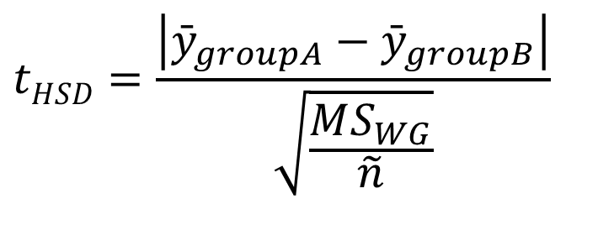
Tukey’s Honest Significant Difference
$$tHSD=\frac{\left|{\bar{y}}_{groupA}−{\bar{y}}_{groupB}\right|}{\sqrt{\frac{MS_{WG}}{\tilde{n}}}}$$
Best estimate we have for the population variance
When the group sizes are unequal, it is:

Slide 39
Additional Resources
What is the probability of making a Type 1 error? Follow this link.
Another great resource here.
Want to learn more about Analysis of Variance? Follow this link.

Slide 40
Questions?

